Slide 1






Development of new potent fragment-based inhibitors targeting CHIKV-NSP3-MD
Hadia Almahli
8th April 2024
Notes:
Covalent warhead
Antiviral drug for SARS cov 2
Gel based data
Picogreen assay
GSH assay
One single dose response
DABCO
SARS-CoV-2 proteins can be grouped in two major classes, structural and nonstrcutural proteins (NSPs). While structural proteins, either hold the RNA genome or are built into the viral envelope, a nonstructural protein encoded by a virus is expressed in infected cells, but not incorporated into the virion particle.

Slide 2



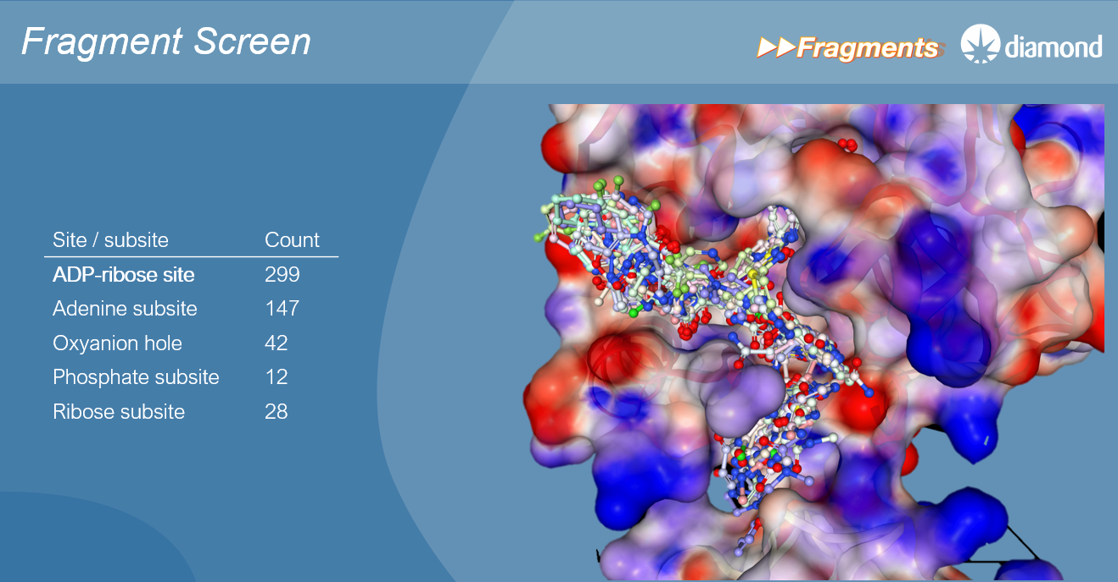
CNP25: CHIKV-Nsp3-MD (LDS hits/ Fragments)
Diamond visit on 22nd March
Automated/ Robotic synthesis at Diamond
Fragmenstein: https://github.com/matteoferla/Fragmenstein
The Fragment Network merges
Fragmentestein generated- Enamine analogues:
268 compounds & 20 unavailable compounds/ 109 fragments
SAR designs: 15 compounds
Knitwork generated compounds: 28 compounds available in the catalogue
SAR exploration with robotic chemistry (to be reviewed on 15th April)
"pure" merges (not necessarily in the catalogue): 11 compounds
(Fstein_pures_adenine_batch1, 2, 3, 4): 900 compounds : picked in near the W148, oxyanion, and adenine sites there are around
Image taken from Diamond presentation
Notes:
268 analoguesSAR designs: [15 compounds]
6 hits (Rahman) to merge , [68 compounds]: the aromatic rings turned into saturated rings and most of the merges have lost the bond-order from the original fragments, and the bicycles disappeared.
There is also a "Fstein_frag_pair_REAL" which includes Fragmenstein generated Enamine analogues of the fragment pairs present in the SeeSAR set. [268 compounds]
@Stephanie Wills has run her Fragment Knitwork algorithm to generate [28 compounds] from the catalogue
Generative designs for review which will form the basis for our formulaic SAR exploration with robotic chemistry (we will order reactants at a later date)
There is a small set of "pure" merges (not necessarily in the catalogue) [11 compounds]
From 72 hits that @Jasmin Aschenbrenner and I picked in near the W148, oxyanion, and adenine sites there are around [900 compounds] acceptable pure Fragmenstein merges uploaded in 4 batches (Fstein_pures_adenine_batch1, 2, 3, 4).

Slide 3
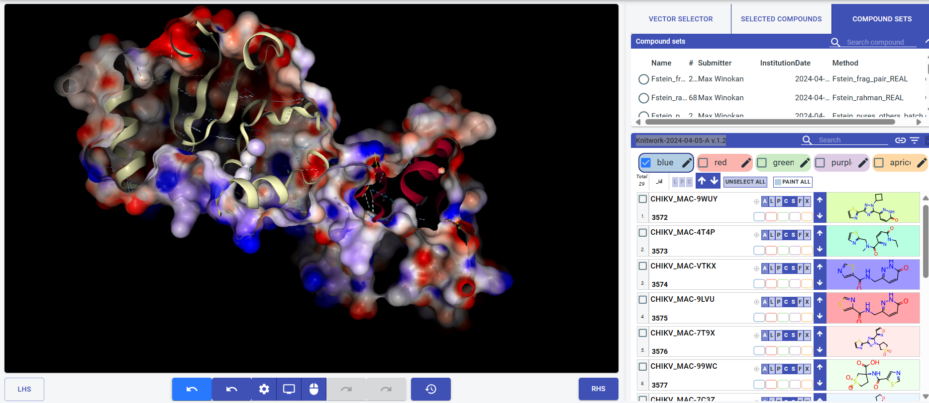
CNP25: CHIKV-Nsp3-MD (LDS hits/ Fragments)
Image taken from Diamond presentation
Notes:
268 analoguesSAR designs: [15 compounds]
6 hits (Rahman) to merge , [68 compounds]: the aromatic rings turned into saturated rings and most of the merges have lost the bond-order from the original fragments, and the bicycles disappeared.
There is also a "Fstein_frag_pair_REAL" which includes Fragmenstein generated Enamine analogues of the fragment pairs present in the SeeSAR set. [268 compounds]
@Stephanie Wills has run her Fragment Knitwork algorithm to generate [28 compounds] from the catalogue
Generative designs for review which will form the basis for our formulaic SAR exploration with robotic chemistry (we will order reactants at a later date)
There is a small set of "pure" merges (not necessarily in the catalogue) [11 compounds]
From 72 hits that @Jasmin Aschenbrenner and I picked in near the W148, oxyanion, and adenine sites there are around [900 compounds] acceptable pure Fragmenstein merges uploaded in 4 batches (Fstein_pures_adenine_batch1, 2, 3, 4).

Slide 4
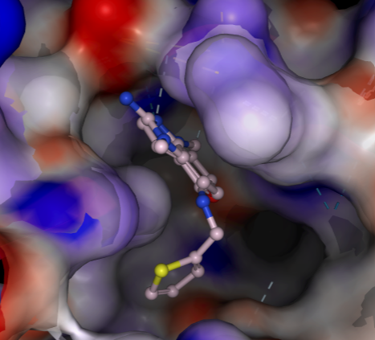
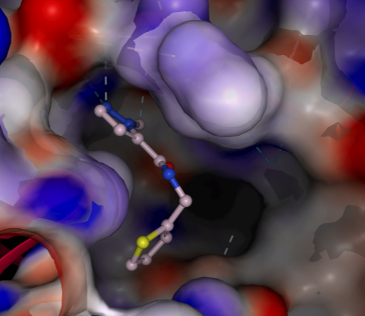
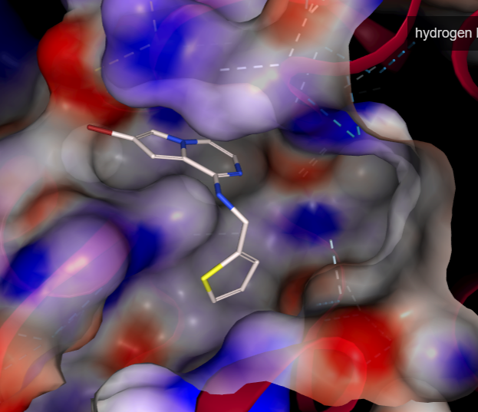
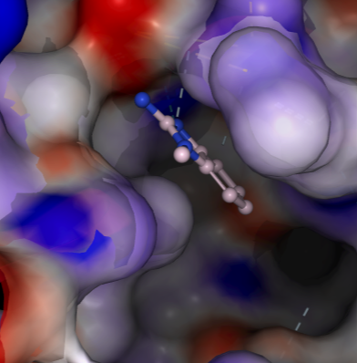
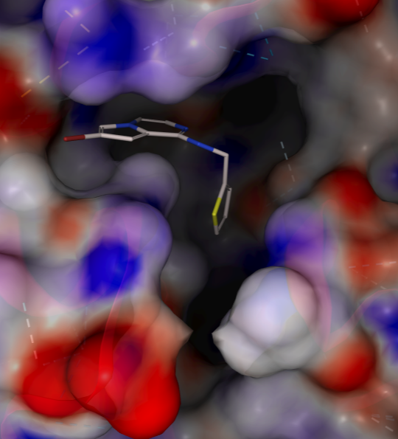
CNP25: CHIKV-Nsp3-MD (LDS hits/ Fragments)
Structure, binding interactions of the original fragments and fitting in the pocket
Fragments merging
Compound NO: 4

Slide 5
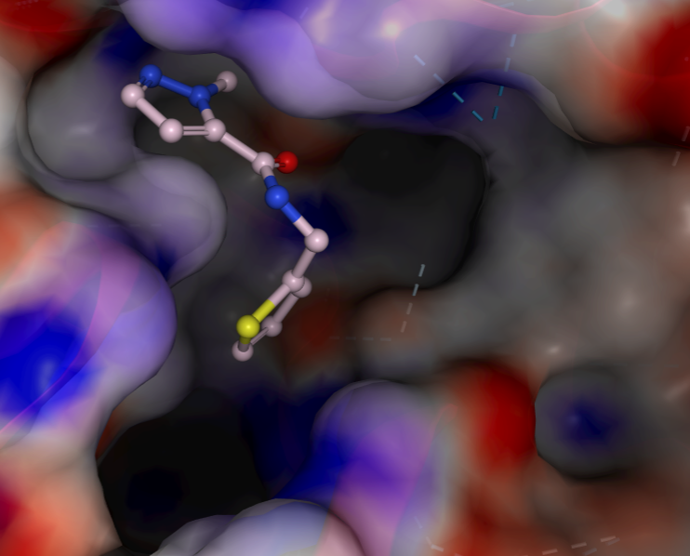
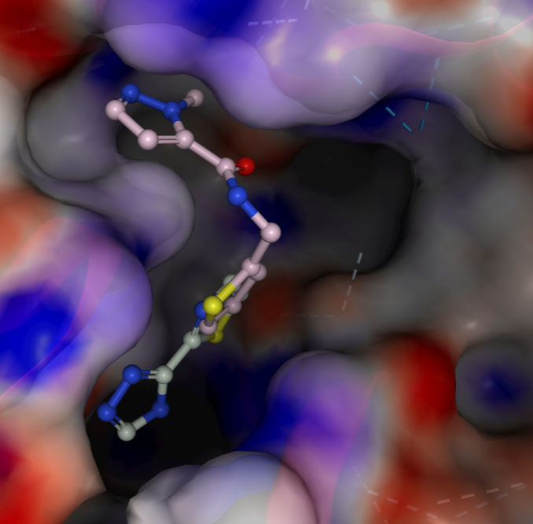
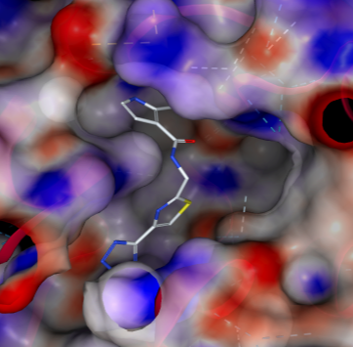
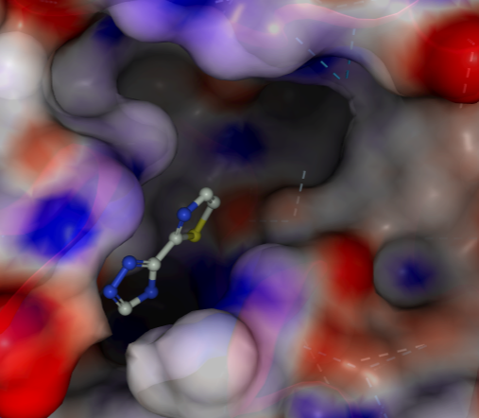
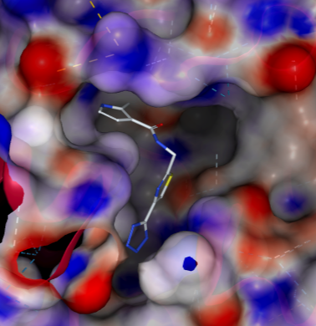
CNP25: CHIKV-Nsp3-MD (LDS hits/ Fragments)
Fragments merging
Compound NO: 258

Slide 6
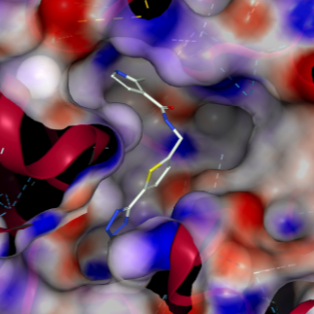
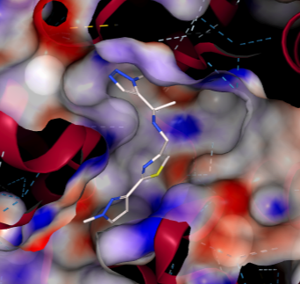
CNP25: CHIKV-Nsp3-MD (LDS hits/ Fragments)
Compound NO: 258
Compound NO: 257
Compound NO: 256

Slide 7
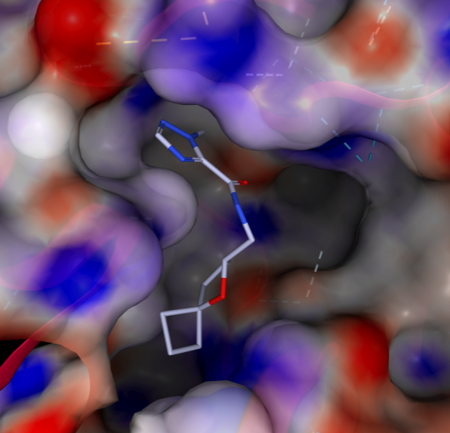
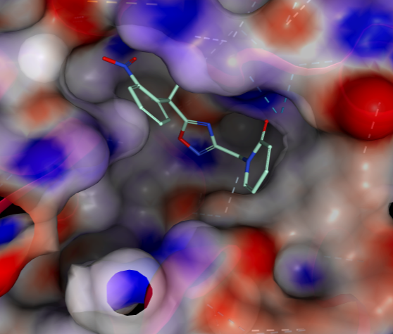
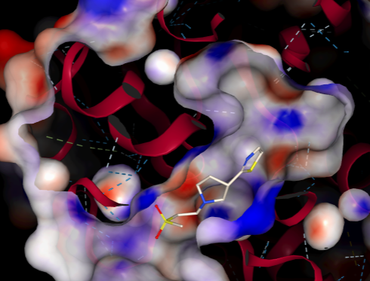
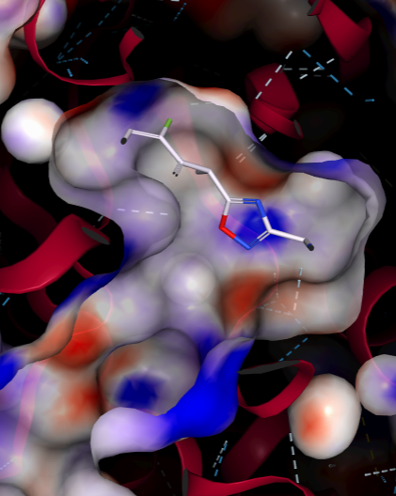
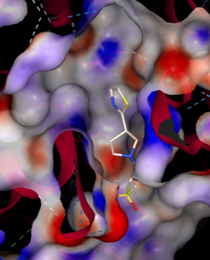
CNP25: CHIKV-Nsp3-MD (LDS hits/ Fragments)
Compound NO: 262
Compound NO: 265
Compound NO: 236
Compound NO: 211
Compound NO: 236

Slide 8
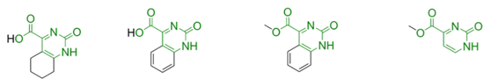
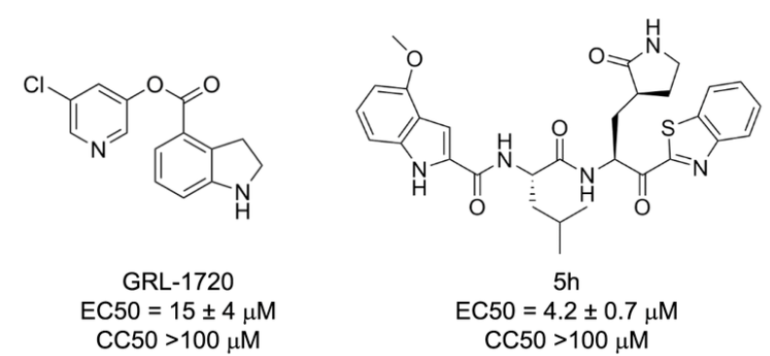
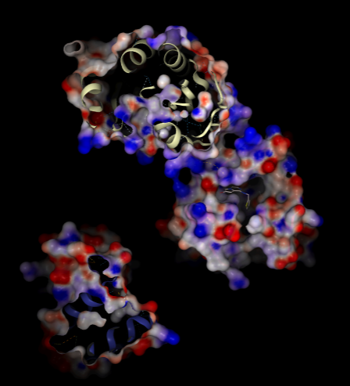
CNP25: CHIKV-Nsp3-MD (LDS hits/ Fragments)
PLOS ONE 16(1): e0245013. https://doi.org/10.1371/journal.pone.0245013
NATURE COMMUNICATIONS | (2021) 12:668 | https://doi.org/10.1038/s41467-021-20900-6 | www.nature.com/naturecommunications
36 analogues selected from Fragmentestein generated- Enamine analogues (268 compounds)
Notes:
Pyrimidone core is a good binder

Slide 9
CNP25: CHIKV-Nsp3-MD (LDS hits/ Fragments)- SAR
SAR Synthetic compounds
Single step synthesis
Single step synthesis
3 steps synthesis

